Slide 1
QCon 2014 Highlights
By Atanas Kuzmanov
Notes:
Tried to capture and squeeze out the most important and applicable bits from the conference.

Slide 2
“Understanding and Using Regular Expressions”
by Damian Conway

Slide 3
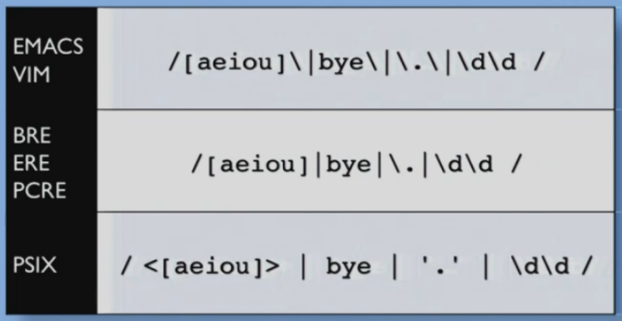
“Understanding and Using Regular Expressions” by Damian Conway
Why do we need Regular Expression languages?
Notes:
Match a vowel, or try to match ‘bye’, or match a literal dot, or match two digits.

Slide 4
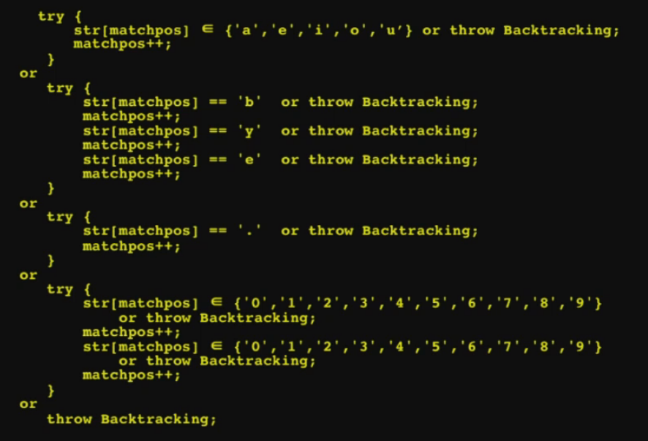
“Understanding and Using Regular Expressions” by Damian Conway
To avoid having to write code like this:
Notes:
This is very unproductive and hard to do.

Slide 5
“Understanding and Using Regular Expressions” by Damian Conway
Regexes are badly misunderstood
They have been lying to us about regexes.
The lie:
“A regular expression is a declarative specification describing the textual structure to which a matching string must conform.”
Regexes are not declarative
Regexes are not descriptive
Regexes are not specifications of strucuture
Regexes are not matching strings by conforming to them
What are regular expressions then?!?!?!
Regexes are code
Regexes are subroutine defenitions!!!
Regexes are functions

Slide 6
“Understanding and Using Regular Expressions” by Damian Conway
“A regular expression is an imperative specification of a block-structured instruction sequence, which is designed to execute some task on a highly specialized virtual machine.”
Regexes are encapsulated sequences of commands, loops, control flow, assertions, and exception handling.
Matching a regex = Calling a function
Passing arguments to that function in the form of a string to match
Letting it execute it’s statements
Getting back a Boolean result – match = true/false
Depending on language you might also get other values or side-effects such as the modification of the original string

Slide 7
“Understanding and Using Regular Expressions” by Damian Conway
Start thinking of regexes as subroutines
Start thinking of each character as an instruction
Start thinking of matching as code execution
Then all you have to do is just to learn their programming language
A horrible and ugly programming language.
You can apply most of your existing programming skills to writing regexes
You need to understand the execution model.
Unfortunately they are not written in just one language, but in languages.

Slide 8
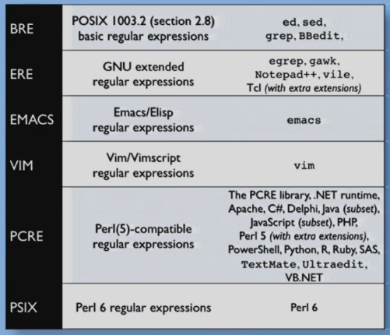
“Understanding and Using Regular Expressions” by Damian Conway
Six major dialects – switching between them is like “jumping from ancient Latin to modern Klingon”.

Slide 9
“Understanding and Using Regular Expressions” by Damian Conway
First of all find out which dialect are you using most of the time and learn that one first!
One of the most practical problems ever – backslashes ‘\’!
Most of the time when you are using a programming language you are using a dialect that doesn’t do much backslashing. But when you go into your editor, Emacs/Vim, and do a search there will be backslashes everywhere. If you are having trouble using your editor, try putting in extra backslashes. In your editor, most of the meta syntax, like repetition, need a backslash.

Slide 10
“Understanding and Using Regular Expressions” by Damian Conway
How are regexes executed?
Running on their own virtual machine, probably on top of the host VM
Theoretically on a finite state machine (FSM)
On practice, on a stack-based machine
Every char is an instruction and usually it is: “Match this char next or else backtrack”
Each instruction can be represented by a link between “state” nodes
Execute regex’s code by traversing the graph

Slide 11
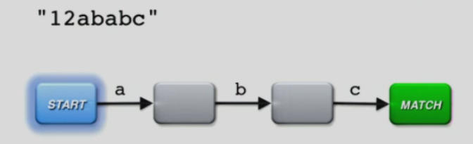
“Understanding and Using Regular Expressions” by Damian Conway
When you reach the “match node” => Success
Try all paths without reaching a “match node” => Fail

Slide 12
“Understanding and Using Regular Expressions” by Damian Conway
This is the single biggest way to improve your regexes!
Whitespace
Whitespace chars are commands in regexes = match a space, tab, etc.
Single biggest defect in regex languages
Single biggest difference between regex languages and other programming languages

Slide 13
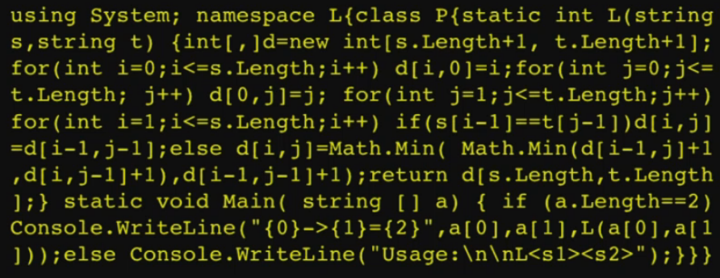
“Understanding and Using Regular Expressions” by Damian Conway
Making regexes more manageable
Whitespaces are arguably the most important part of any code to make it easy to read, and is not available to you in regexes as it’s a command.

Slide 14
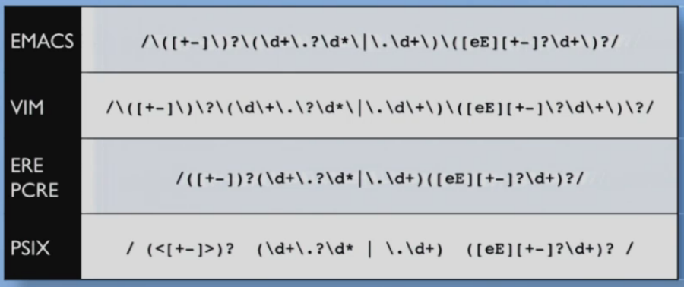
“Understanding and Using Regular Expressions” by Damian Conway
A “simple” floating point number regex.
Notice the Perl6 (PSIX) syntax, in Perl6 whitespace is non meaningful.
In Perl6 comments are a kind of whitespace.

Slide 15
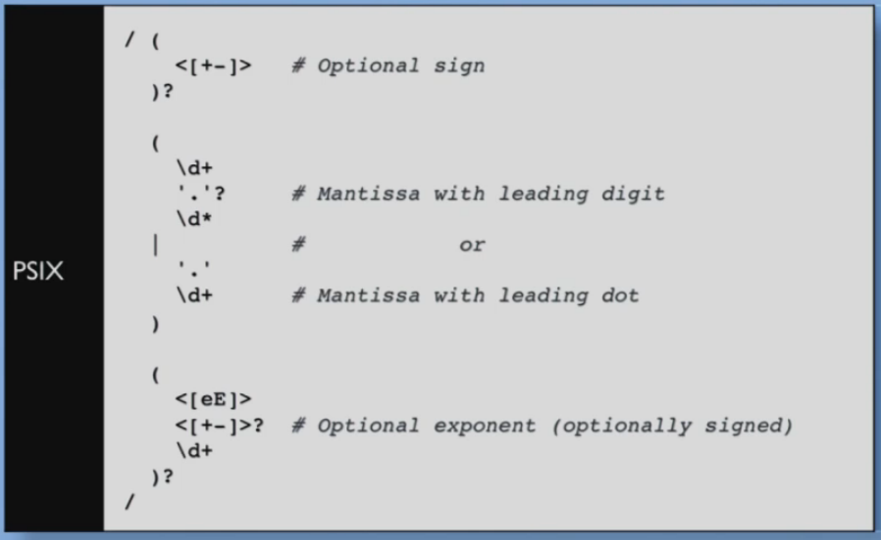
“Understanding and Using Regular Expressions” by Damian Conway
Readable; Comprehensible; Debuggable; Maintainable;

Slide 16
“Understanding and Using Regular Expressions” by Damian Conway
If your language is not Perl6, but a PCRE or (some) ERE based language then you can use magic!
You can use the magic “(?x)” flag at the start of your regex, which turns off the significance of white space and comments throughout the rest of your regex.
If your regex dialect allows this flag, you should use it!

Slide 17
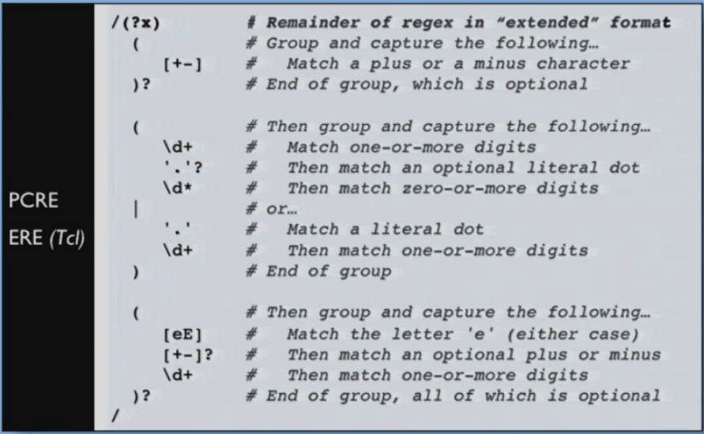
“Understanding and Using Regular Expressions” by Damian Conway

Slide 18
“Understanding and Using Regular Expressions” by Damian Conway
Most other regex dialect don’t have that extended formatting.
You can still sometimes cheat, especially if the regex is part of a larger program.

Slide 19
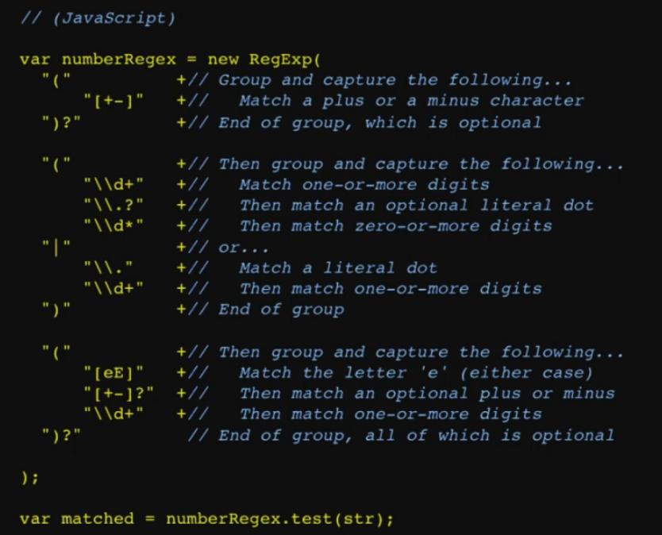
“Understanding and Using Regular Expressions” by Damian Conway
JavaScript
Use separate strings to build the regex, and you can use whitespaces and even comments.

Slide 20
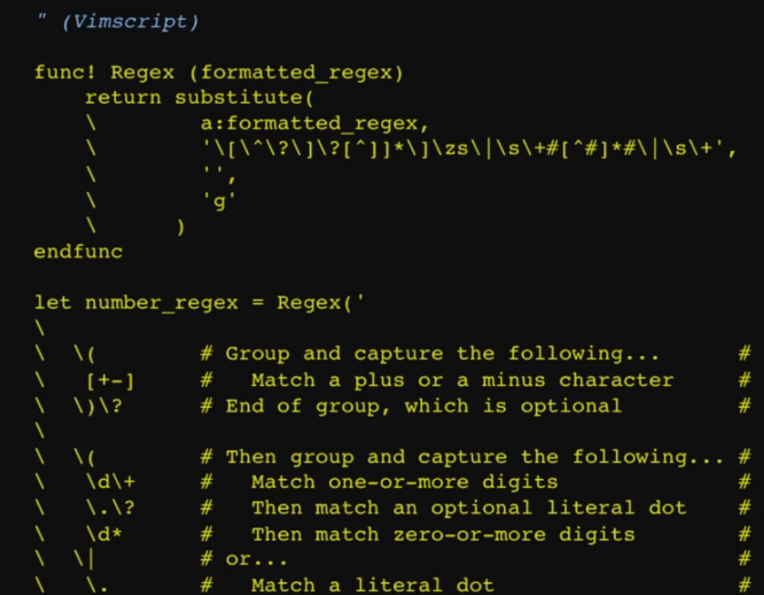
“Understanding and Using Regular Expressions” by Damian Conway
Vimscript
Write a function that takes a formatted regex and uses a horrible little regex of it’s own, to wipe out all the whitespaces and comments.

Slide 21
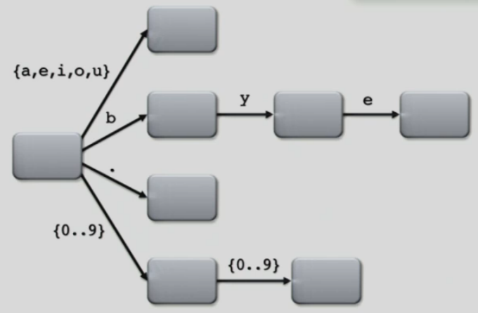
“Understanding and Using Regular Expressions” by Damian Conway
To get better at regexes try and write out the graph that is corresponding.
Sometimes just writing out the graph is enough to understand the regex, especially in debugging.
For more in depth topics about regexes, such as Nondeterministic finite automaton (NFA) vs. Deterministic finite automaton (DFA), please see the video talk, link provided in the “References and Resources” section.

Slide 22
“Understanding and Using Regular Expressions” by Damian Conway
Regex Summary
The regex engine is a VM
Regexes are code
Think about regexes the same way you think about code. They are not descriptions of what we want. They are instructions of what to do.
Design them the same way you design code
Layout is the key to comprehensibility. If possible use the extended format.
If possible reduce backtracking to get more efficient regexes.

Slide 23
“Life, The Universe, and Everything”
by Damian Conway

Slide 24
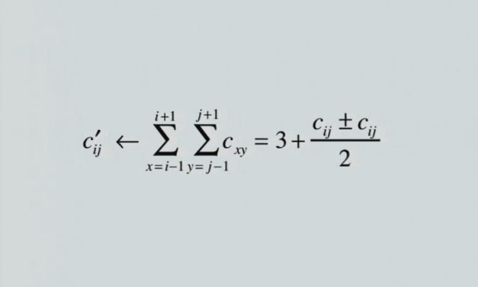
“Life, The Universe, and Everything” by Damian Conway
GAME OF LIFE IS AWESOME!
Created by British mathematician John Horton Conway in 1970.
Designed and then proved to be a full computational platform!
Notes:
This mathematical equation is the Game of Life.

Slide 25

“Life, The Universe, and Everything” by Damian Conway

Slide 26
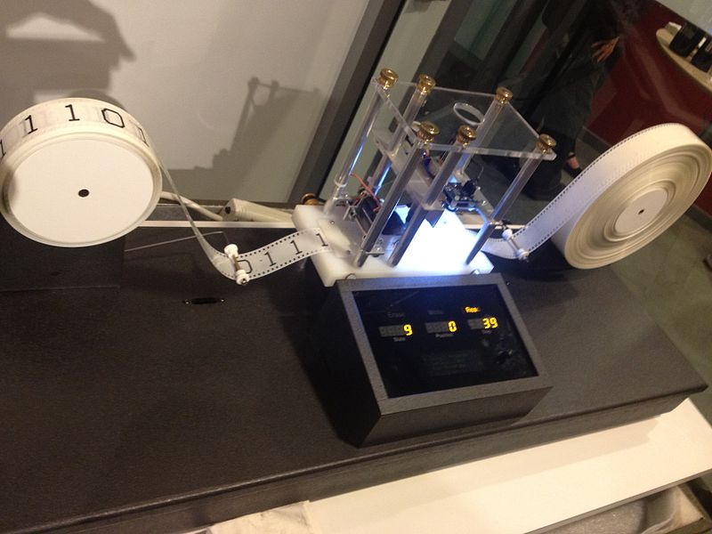
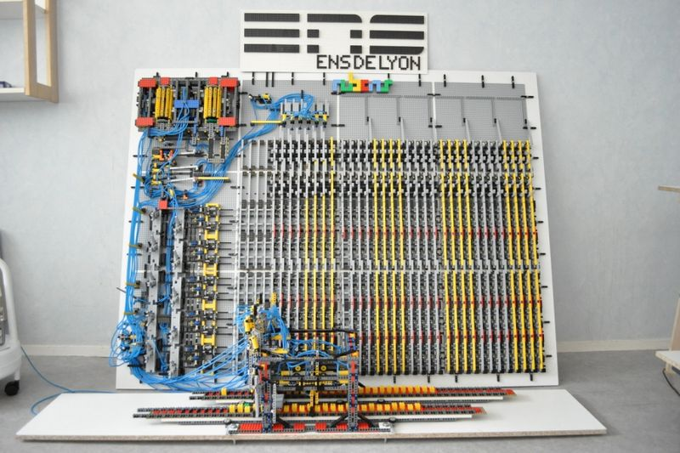
“Life, The Universe, and Everything” by Damian Conway
Turing Machine
A Turing machine is a hypothetical device that manipulates symbols on a strip of tape according to a table of rules. Despite its simplicity, a Turing machine can be adapted to simulate the logic of any computer algorithm.
Notes:
A lot of versions of the Turing Machine have been built, some of them even from Lego.

Slide 27
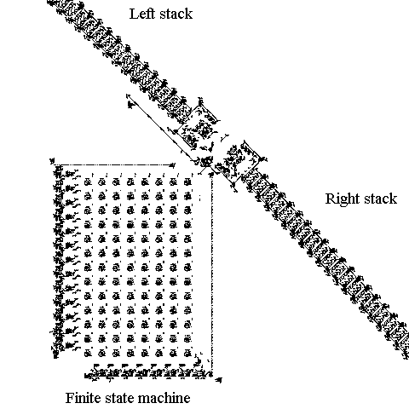
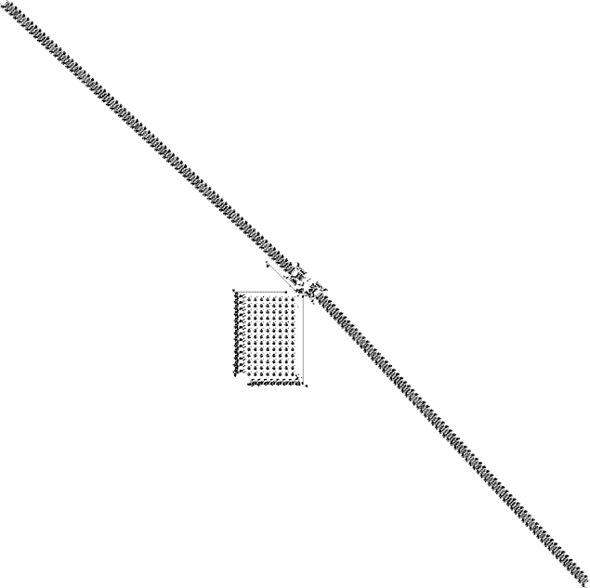
“Life, The Universe, and Everything” by Damian Conway
Paul Rendell built a Turing Machine out of the Game of Life
https://www.youtube.com/watch?v=My8AsV7bA94
Notes:
Video to give idea about the scale of the complexity.

Slide 28
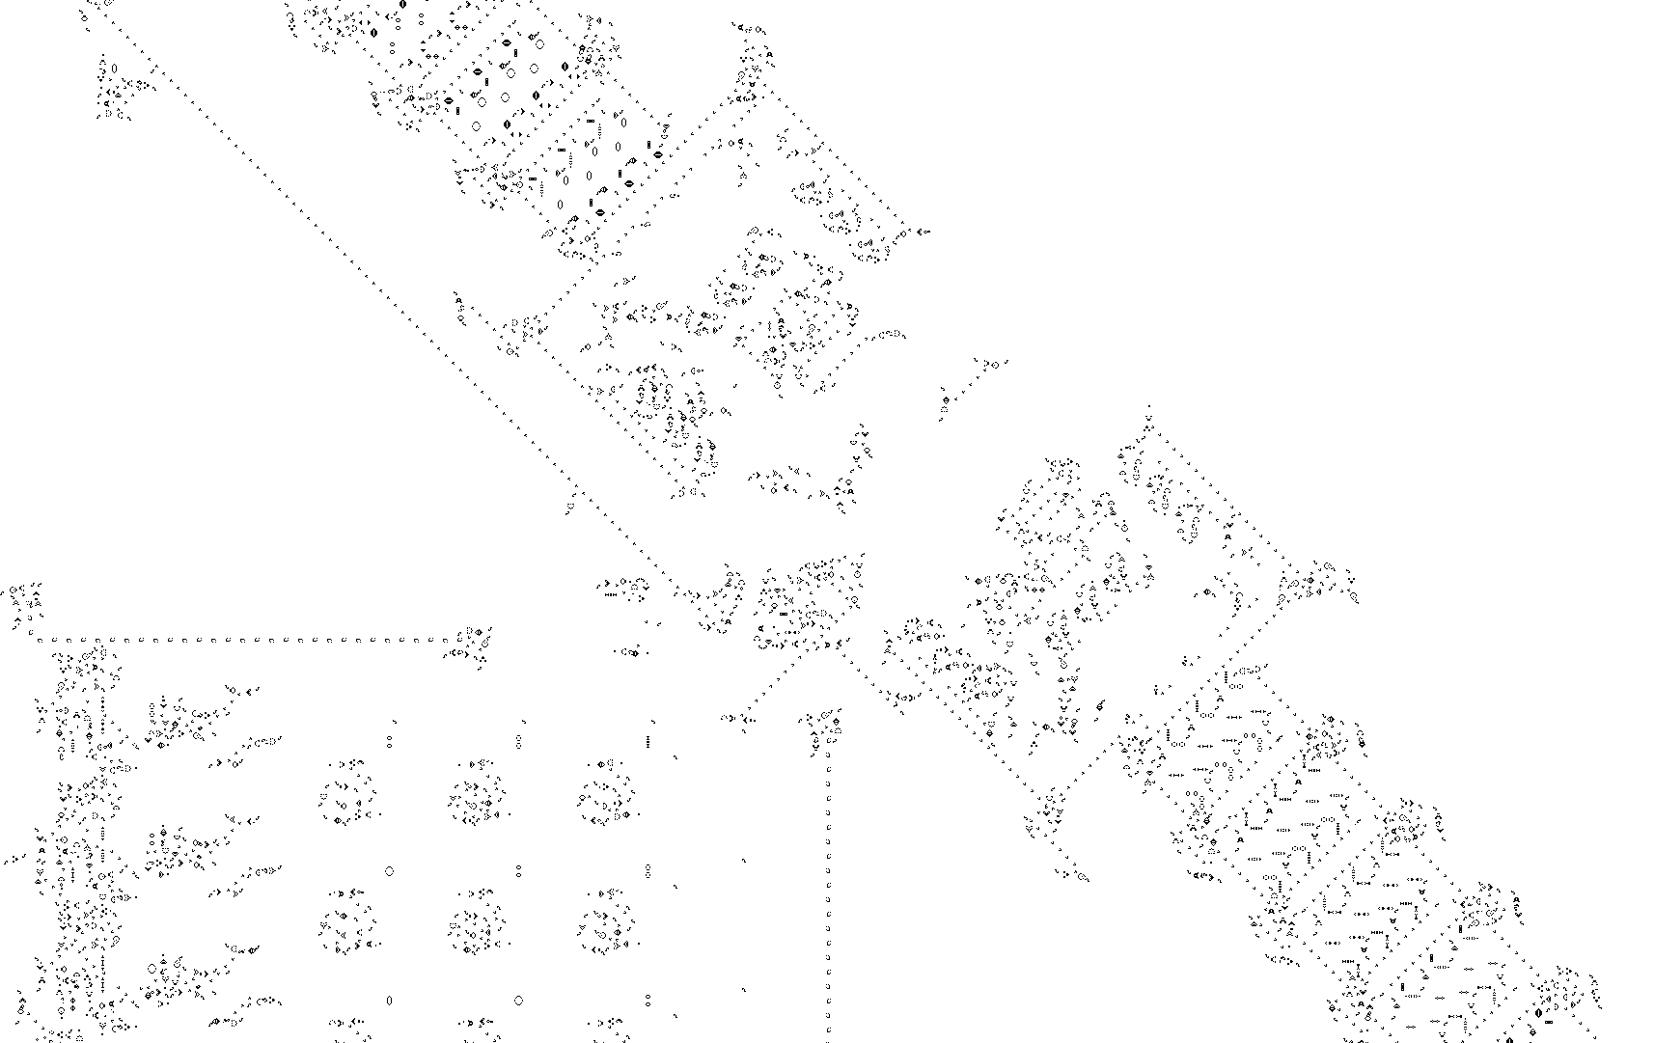
“Life, The Universe, and Everything” by Damian Conway

Slide 29




“Life, The Universe, and Everything” by Damian Conway
Components

Slide 30


“Life, The Universe, and Everything” by Damian Conway
Memory cell
Notes:
Built from guns, which when colliding produce gliders.

Slide 31

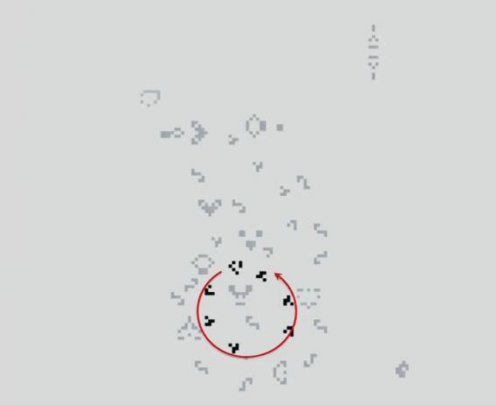
“Life, The Universe, and Everything” by Damian Conway
Notes:
8 spinning in a circle gliders = 8 bits

Slide 32
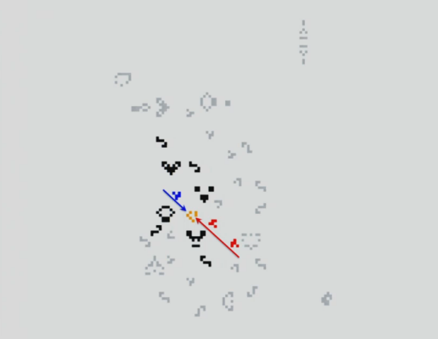

“Life, The Universe, and Everything” by Damian Conway
Notes:
Duplicator gliders. One goes back in the circle, the other goes out in the stream

Slide 33
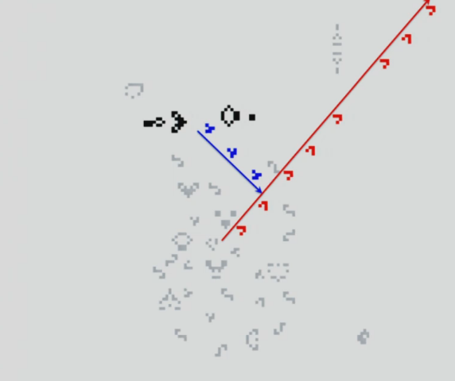
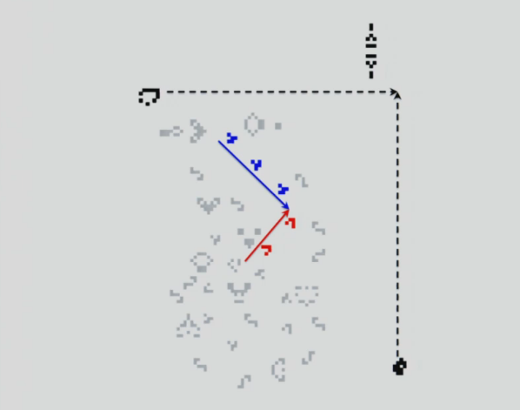
“Life, The Universe, and Everything” by Damian Conway
Notes:
Cut of gliders, cutting off the duplicated glider stream.
Second cut off gliders, to cut off the first cut off gliders, to allow the stream of duplicated gliders to flow.
The cut off is enough to allow exactly 8 duplicated gliders to flow out = reading 8 bits from the contents of the memory cell.

Slide 34
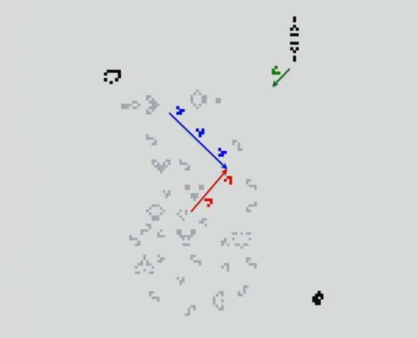
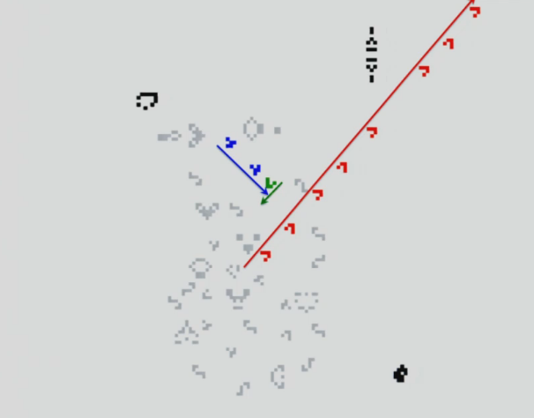
“Life, The Universe, and Everything” by Damian Conway
Notes:
Second cut off gliders, to cut off the first cut off gliders, to allow the stream of duplicated gliders to flow.
The cut off is enough to allow exactly 8 duplicated gliders to flow out = reading 8 bits from the contents of the memory cell.

Slide 35
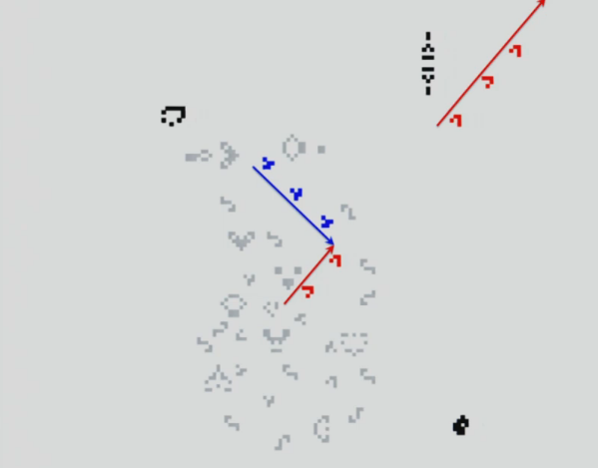
“Life, The Universe, and Everything” by Damian Conway
8 bit Memory cell
Notes:
The result – an 8 bit memory cell.

Slide 36
“Fault Tolerance 101”
by Joe Armstrong (Creator of Erlang)

Slide 37
“Fault Tolerance 101” by Joe Armstrong (Creator of Erlang)
Defensive programming is an useless side effect of sequential programming.
It should be Fault Tolerant programming.
Fault tolerant system = Scalable system
The question to ask is “What to do when an error occurs?”
Nothing
Crash
Ignore it
Hide it

Slide 38
“Fault Tolerance 101” by Joe Armstrong (Creator of Erlang)
Specifications?! – They tell you what to do when things happen, but not when things don’t happen.
Programming is the act of turning an inexact description of something (the specification) into an exact description of something (the program).
What is fault tolerance?
The ability to behave in a sensible manner in the presence of a failure. (Consumer software, websites)
The ability to behave exactly as specified despite failures. (Air traffic control, Nuclear power station control)

Slide 39
“Fault Tolerance 101” by Joe Armstrong (Creator of Erlang)
Hardware and software failures
Different types of software and hardware bugs
Heisenbug – Bug that seems to disappear or alter it’s behavior when one attempts to study it.
Bohrbug - by opposition, is a "good, solid bug". Like the deterministic Bohr atom model, they do not change their behavior and are relatively easily detected.
Mandelbug - (named after Benoît Mandelbrot's fractal) is a bug whose causes are so complex it defies repair, or makes its behavior appear chaotic or even non-deterministic.
Schrödinbug - (named after Erwin Schrödinger and his thought experiment) is a bug that manifests itself in running software after a programmer notices that the code should never have worked in the first place.
Hindenbug - (named after Hindenburg disaster) is a bug with catastrophic behavior.

Slide 40
“Fault Tolerance 101” by Joe Armstrong (Creator of Erlang)
Example of a Heisenbug
A cosmic ray hits the memory cell where b is stored and changes the value from 2 to 0.
function f() {
int a = 10;
int b = 2;
return a/b;
}

Slide 41
“Fault Tolerance 101” by Joe Armstrong (Creator of Erlang)
Summary
Design with small isolated components
Fault Tolerant = Scalable
Small components = Understandable

Slide 42
“Fault Tolerance Made Easy”
by Uwe Friedrichsen

Slide 43
“Fault Tolerance Made Easy” by Uwe Friedrichsen
“IT’S ALL ABOUT PRODUCTION!”
Production
Availability
Resilience
Fault Tolerance

Slide 44
“Fault Tolerance Made Easy” by Uwe Friedrichsen
Fault tolerance patterns
Pattern #1 – Timeouts
Determining Timeout Duration
Configurable Timeouts
Self-Adapting Timeouts (monitoring triggered)
// Basics
myObject.wait(); // Do not use this by default
myObject.wait(TIMEOUT); // Better use this
// Some more basics
myThread.join(); // Do not use this by default
myThread.join(TIMEOUT); // Better use this

Slide 45
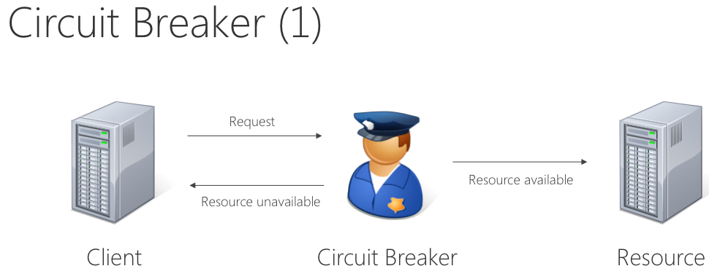
“Fault Tolerance Made Easy” by Uwe Friedrichsen
Pattern #2 – Circuit Breaker
Doesn’t wait for a timeout, if resource is unavailable it will return immediately
Thread-Safe Circuit Breaker
Failure Types
Tuning Circuit Breakers

Slide 46
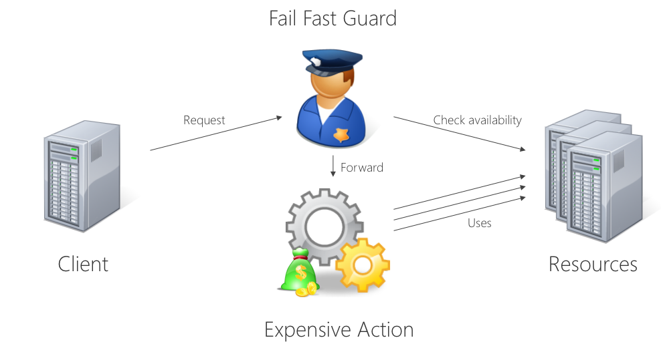
“Fault Tolerance Made Easy” by Uwe Friedrichsen
Pattern #3 - Fail Fast
If you know you are going to fail, you better fail fast.
Still probability of failure, this is just about reducing that probability.

Slide 47
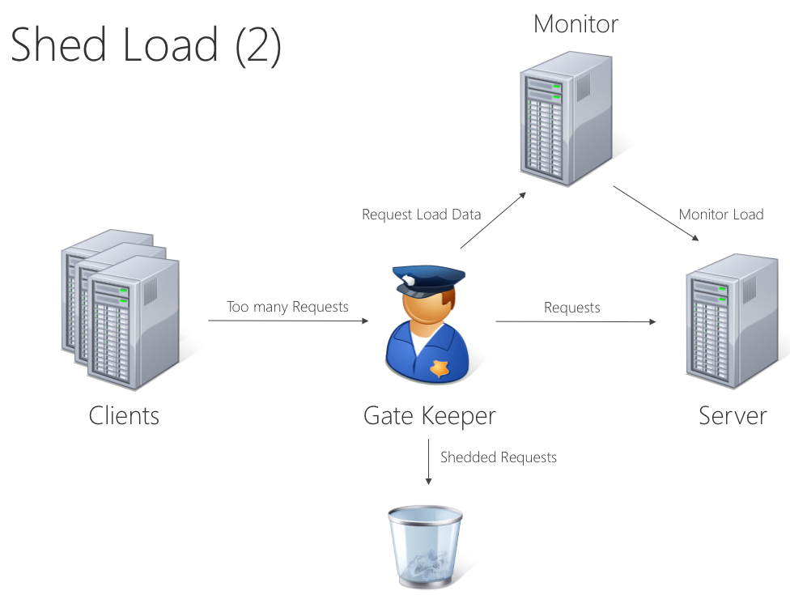
“Fault Tolerance Made Easy” by Uwe Friedrichsen
Pattern #4 – Shed Load
Aims to keep system responsive over a period of high load
Shedding Strategy
Retrieving Load
Tuning Load Shedders

Slide 48
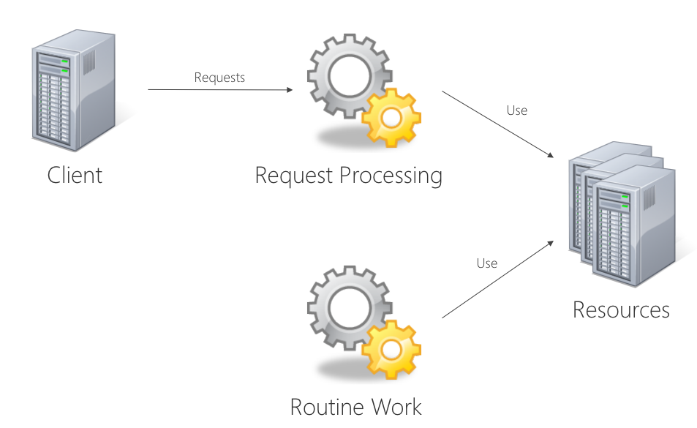
“Fault Tolerance Made Easy” by Uwe Friedrichsen
Pattern #5 – Deferrable Work
Delay Strategy
Retrieving Load
Tuning Deferrable Work

Slide 49
"Impossible Programs”
by Tom Stuart

Slide 50
"Impossible Programs" by Tom Stuart
PROGRAMS CAN’T DO EVERYTHING!
Universal systems can run software.
We don’t just want machines, we want general-purpose machines.
Programs are data
UNIVERSAL SYSTEMS
+
PROGRAMS ARE DATA
=
INFINITE LOOPS

Slide 51
"Impossible Programs" by Tom Stuart
This program loops forever.
Can we write a program that can decide this in general?
NO!
This question is called the halting problem.
input = $stdin.read
while true
# do nothing
end
puts input.upcase

Slide 52
"Impossible Programs" by Tom Stuart
Not only can we not ask “does this program halt?”, we also can’t ask “does this program do what I want it to do?”.
This is Rice’s theorem
“Any interesting property of program behavior is undecidable.”
We can’t look into the future and predict what a program will do.
The only way to ﬁnd out for sure is to run it.
But when we run a program, we don’t know how long we have to wait for it to ﬁnish. (Some programs never will.)
Any system with enough power to be self-referential can’t correctly answer every question about itself.
We need to step outside the self-referential system and use a different, more powerful system to answer questions about it.
But there is no more powerful system to upgrade to.

Slide 53
"Impossible Programs" by Tom Stuart
So how can we cope?!
Ask undecidable questions, but give up if an answer can’t be found in a reasonable time.
Ask several small questions whose answers provide evidence for the answer to a larger question.
Ask decidable questions by being conservative.
Approximate a program by converting it into something simpler, then ask questions about the approximation.

Slide 54
"A Big Data Arsenal for the 21st Century”
by Matt Asay

Slide 55
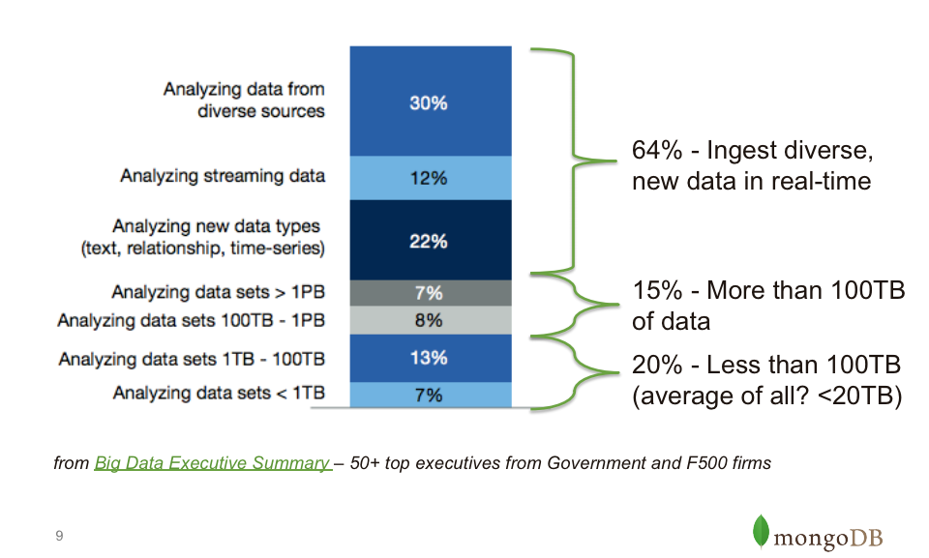
"A Big Data Arsenal for the 21st Century” by Matt Asay
How big is Big Data?
How big are we?
I used to think we might need Big Data soon at the BBC, but this talk changed my beliefs in the opposite direction as we are not actually that big in terms of processing data, as we have no need for that at the moment.

Slide 56
"What Every Hipster Should Know About Functional Reactive Programming”
by Bodil Stokke

Slide 57
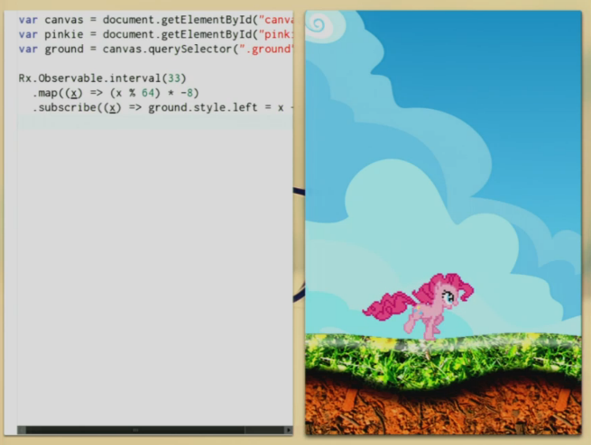
"What Every Hipster Should Know About Functional Reactive Programming" by Bodil Stokke
Reactive programming = Event driven programming
Reactive programming – just a new term coined by Typesafe?!

Slide 58
"Lambdas & Streams: Taking the Hard Work Out of Bulk Operations in Java SE 8”
by Simon Ritter

Slide 59
"Lambdas & Streams: Taking the Hard Work Out of Bulk Operations in Java SE 8" by Simon Ritter
Java is evolving
Java needs lambda statements
Significant improvements in existing libraries are required
Require a mechanism for interface evolution
Solution: virtual extension methods
Bulk operations on Collections
Much simpler with Lambdas
Java SE 8 evolves the language, libraries, and VM together
Possible Scala alternative?!
Maybe… maybe not… the Java lambdas syntax could turn out to be ugly.

Slide 60
"Lambdas & Streams: Taking the Hard Work Out of Bulk Operations in Java SE 8" by Simon Ritter
Inner classes vs. Lambdas example
List<Student> students = …
double highestScore =
students.filter(new Predicate<Student>() {
public boolean op(Student s) {
return s.getGradYear() == 2011;
}
}).map(new Mapper<Student,Double>() {
public Double extract(Student s) {
return s.getScore();
}
}).max();
SomeList<Student> students = ...
double highestScore =
students.stream()
.filter(Student s -> s.getGradYear() == 2011)
.map(Student s -> s.getScore())
.max();
More readable
More abstract
Less error-prone
No reliance on mutable state
Easier to make parallel
Notes:
Stream allows to chain functions.

Slide 61
References & Resources
Slides: http://qconlondon.com/london-2014/schedule/index.jsp
Videos: http://www.infoq.com/conferences/qconlondon2014
http://en.wikipedia.org/wiki/Conway's_Game_of_Life
http://www.infoq.com/presentations/programming-limits?utm_source=infoq&utm_medium=QCon_EarlyAccessVideos&utm_campaign=QConLondon2014
http://rendell-attic.org/gol/tm.htm
https://www.youtube.com/watch?v=My8AsV7bA94
http://rendell-attic.org/gol/utm/pictures/utm-s2.png
http://pentadecathlon.com/lifeNews/2011/01/2011-01-10-overview.PNG
http://rendell-attic.org/gol/turing_js_r.gif
http://users.ugent.be/~jbaetens/images/Game.gif
http://en.wikipedia.org/wiki/Turing_machine
http://en.wikipedia.org/
http://en.wikipedia.org/wiki/Heisenbug
http://en.wikipedia.org/wiki/Rice's_theorem

Slide 62
References & Resources
http://qconlondon.com/london-2014/presentation/Life,%20The%20Universe,%20and%20Everything
http://qconlondon.com/london-2014/presentation/Understanding%20&%20Using%20Regular%20Expressions
http://qconlondon.com/london-2014/presentation/Fault%20Tolerance%20101
http://qconlondon.com/london-2014/presentation/Fault%20Tolerance%20Made%20Easy%20-%20A%20Head-start%20to%20Resilient%20Software%20Design
http://qconlondon.com/london-2014/presentation/Impossible%20Programs
http://qconlondon.com/london-2014/presentation/A%20Big%20Data%20Arsenal%20for%20the%2021st%20Century
http://qconlondon.com/london-2014/presentation/HTML5,%20Angular.js,%20Groovy,%20Java,%20MongoDB%20all%20together%20-%20what%20could%20possibly%20go%20wrong?
http://qconlondon.com/london-2014/presentation/What%20Every%20Hipster%20Should%20Know%20About%20Functional%20Reactive%20Programming
http://qconlondon.com/london-2014/presentation/Lambdas%20&%20Streams:%20Taking%20the%20Hard%20Work%20Out%20of%20Bulk%20Operations%20in%20Java%20SE%208
https://production.bbc.co.uk/academy/technology/software-engineering/Talks
http://en.wikipedia.org/wiki/Reactive_programming
https://typesafe.com/

Slide 63
THE END
Thank you!
Questions?

